Slide 1
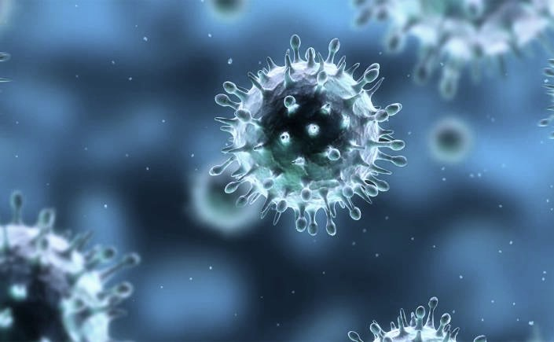
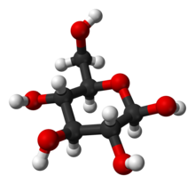
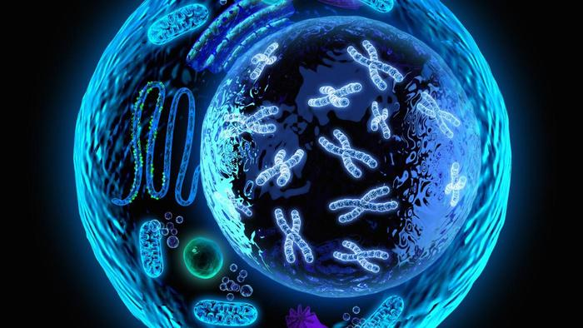
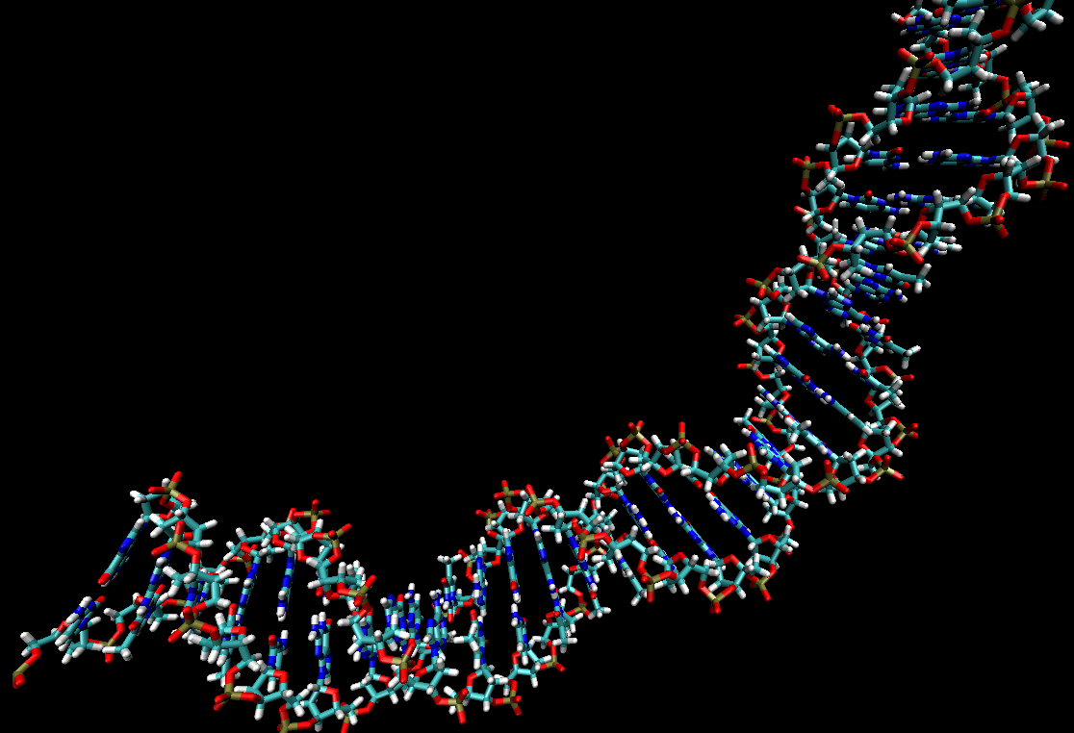
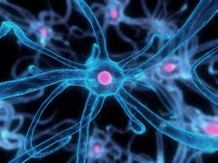
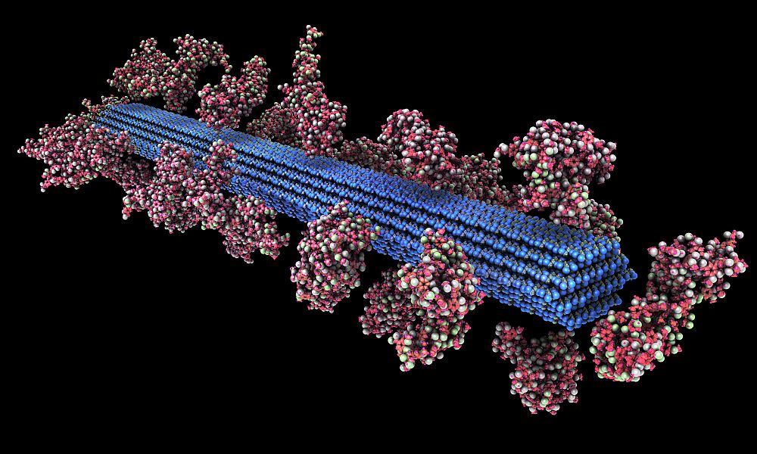

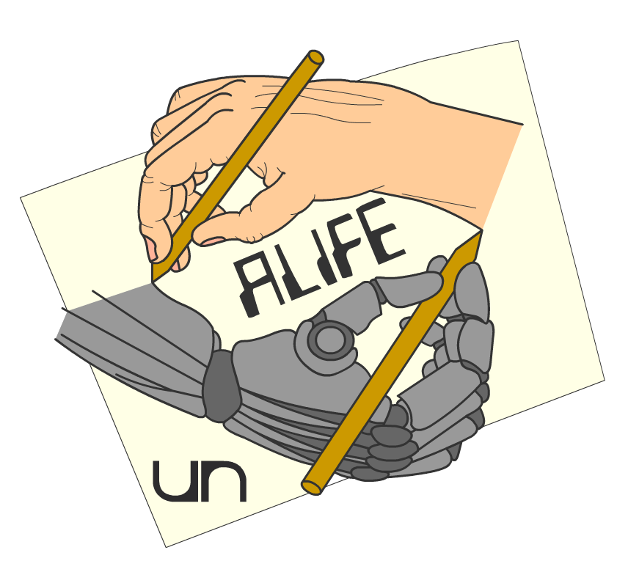
Artificial Chemistries
The chemistry of life
Daniel Rodríguez Cárdenas
Carlos Andrés Sierra
Alife research group,
Universidad Nacional,
Bogotá, Colombia.
Notes:
© Copyright Showeet.com – Free PowerPoint Templates

Slide 2
Basic definition
“Artificial chemistries stand to Artificial Life as chemistry stands to biology”
The link is related to the origin of life from inanimate matter.
Understanding life starts with understanding basic chemistry and from there, organic chemistry and bio-chemistry.
Biochemistry is more complex than its inorganic counterpart, because of the ability of biomolecules to form new compounds in a combinatorial way.

Slide 3
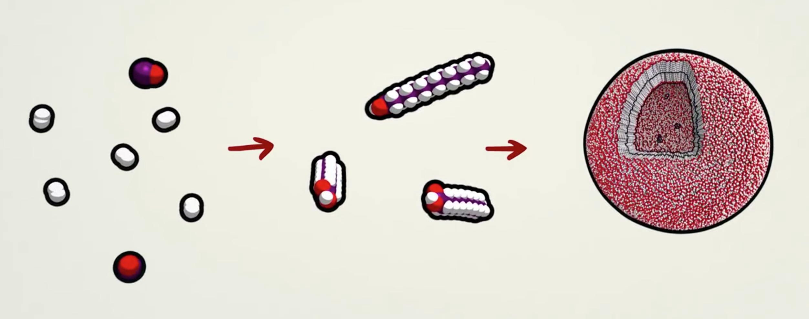
How life can emerge?

Slide 4
Reasons!
Understand and model those origin of life phenomena.
Offer a common view on the combinatorial spaces and their innovation potential.
Is a source of inspiration for chemical computing models where algorithms displaying emergent properties toward complex increasing by self-organization and robustness properties.
It is important to understand and engineer new wet artificial chemistries in the realm of unconventional and natural computation.

Slide 5
| What is life?

Slide 6
A definition
“Self-sustaining chemical system capable of undergoing Darwinian evolution”
“Out-of-equilibrium system able to build internal order by taking nutrients from the environment”
“Auto-poietic system, self-producing and self-manteining”

Slide 7
But… what is life?
A minimal cell operates autonomously by extracting energy from its environment (food or light sources), and using this energy to maintain itself, usually expelling some waste material in the process.
The minimal cell requires:
A membrane defining the boundary and enclosing its content;
An information carrier subsystem containing its genetic material, and determining how it is reliably copied to the next generation.
A metabolic subsystem, that keeps the cell alive by turning food materials or energy into the essential building blocks needed for maintaining all the three subsystems together in a functional way.

Slide 8
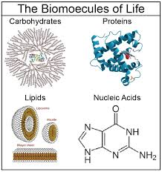
The building blocks of life

Slide 9
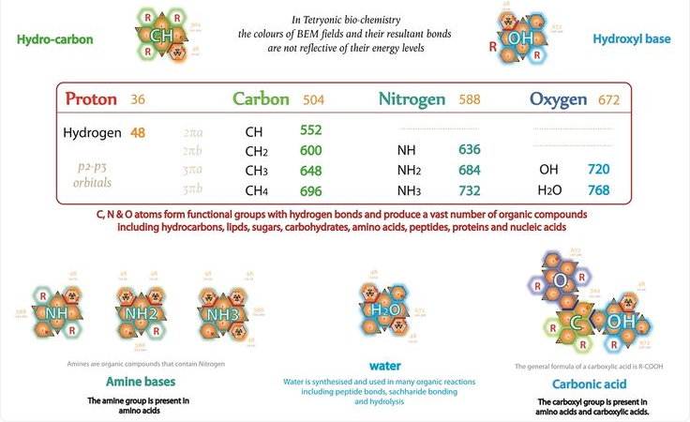
The building blocks of life

Slide 10
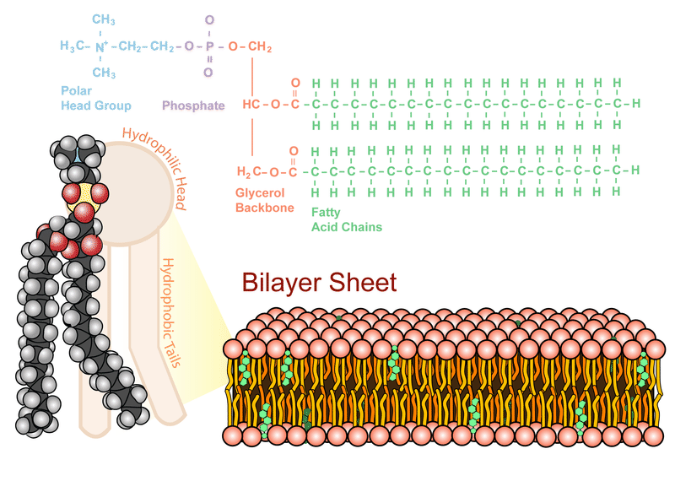
Self-assembly fatty acid structures

Slide 11
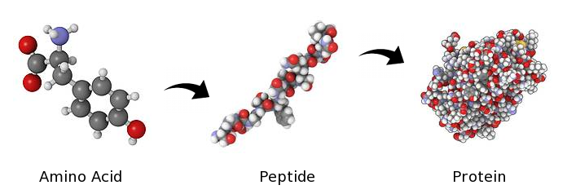
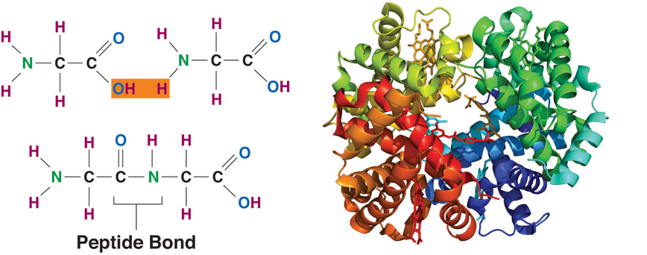
Proteins

Slide 12
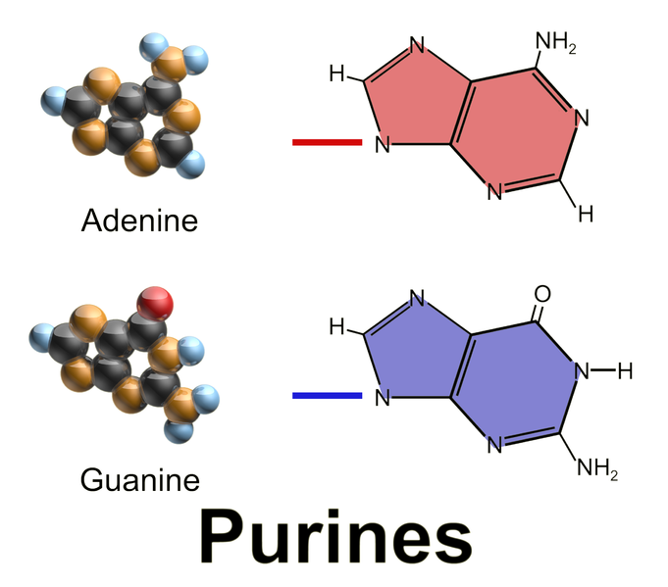
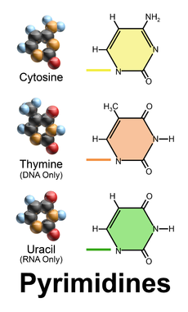
Nucleic Acids

Slide 13
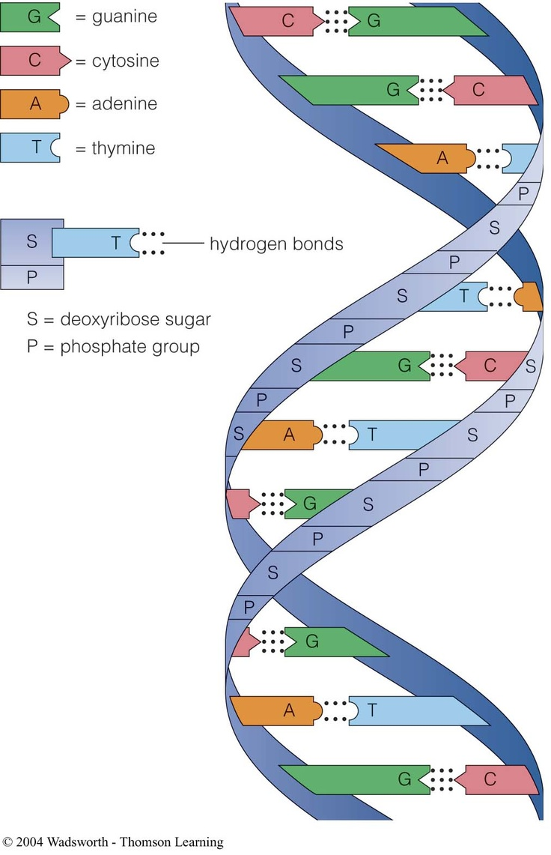
The DNA

Slide 14
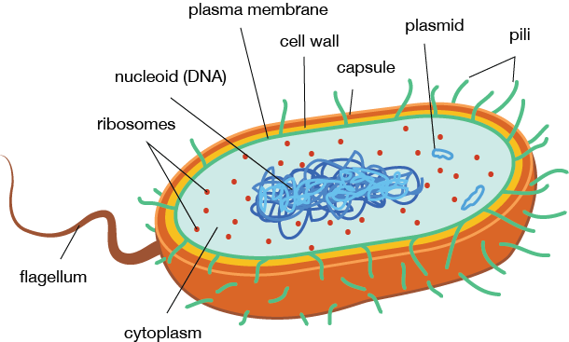
The modern cells
Prokaryotic cell

Slide 15
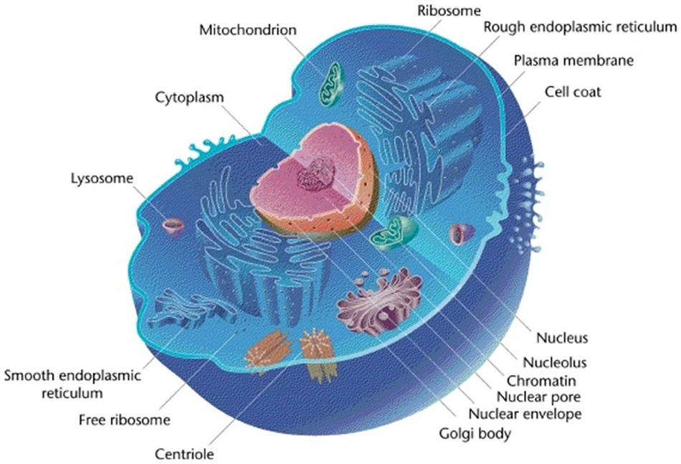
The modern cells

Slide 16

The modern cell

Slide 17
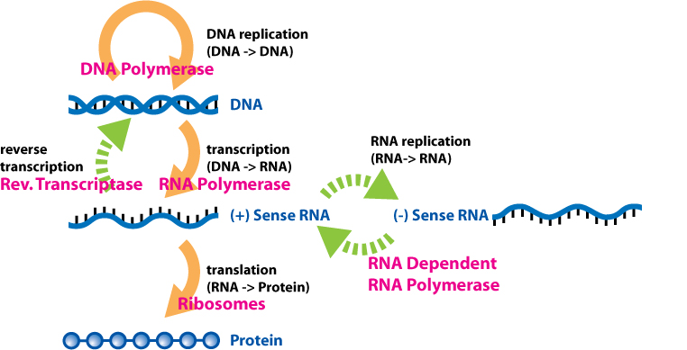
Gene expression and Regulation

Slide 18
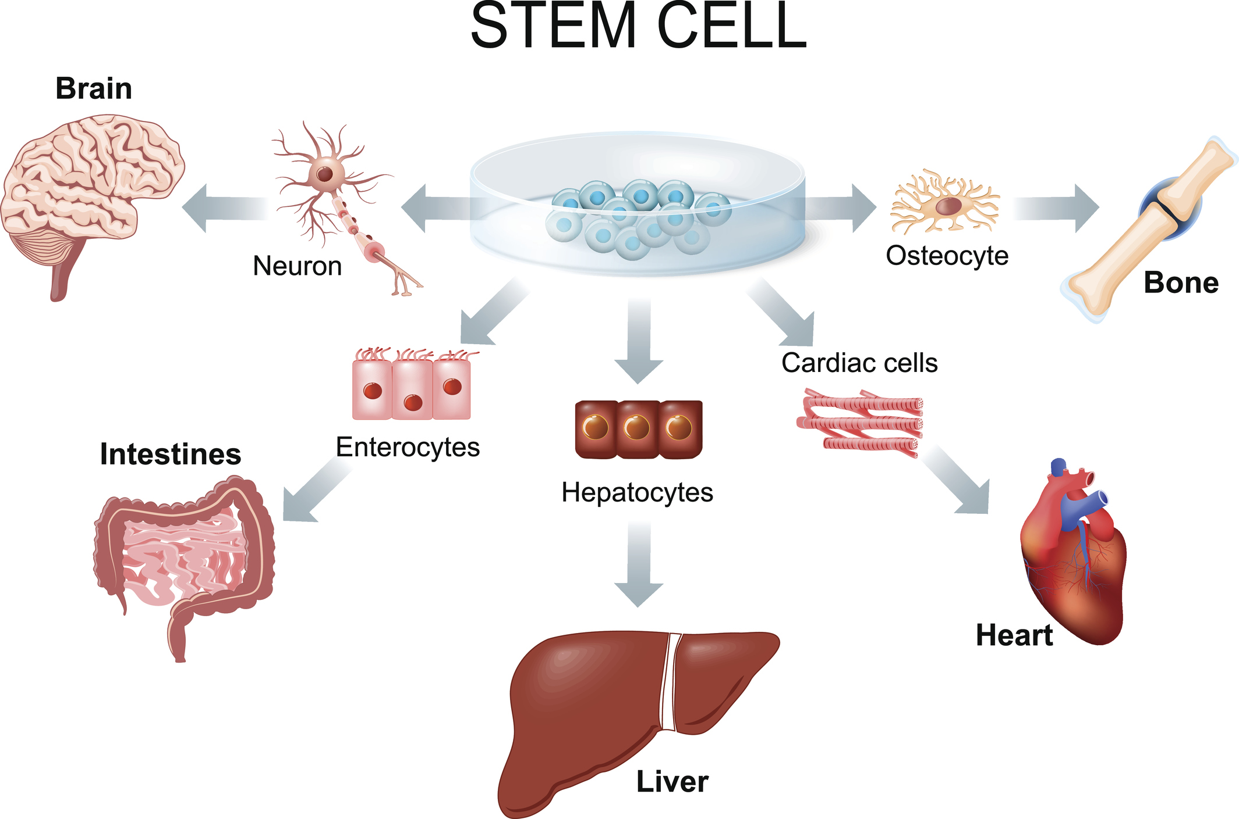
Cell differentiation

Slide 19
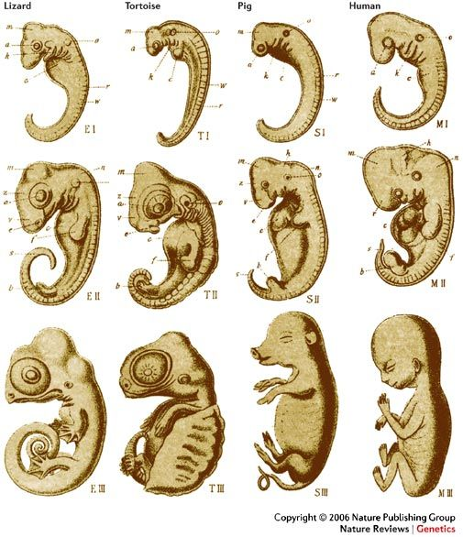
Examples of morphogenesis

